Slide 1
Data Mining vs. Data Engineering
INFO 523 Final Project
Jose Mendoza
8/13/2024
Notes:
1

Slide 2
AGENDA
Introduction: Data Mining and Data Engineering
Roles and Responsibilities
Data Lifecycle
Challenges and Best Practices
Impact on Business
Real World Solution
Conclusion
Notes:
2

Slide 3
Introduction: Data Mining
Definition:
The process of discovering patterns, correlations, and insights from large datasets using statistical and computational methods.
History:
It began in the 1960s and 1970s with basic data analysis and pattern recognition techniques.
It is now a crucial component of data science with applications across different industries.
Key Concepts:
Patterns and trends
Anomaly detection
Predictive modeling
Clustering
Regression
Summarization
Notes:
2

Slide 4
Introduction: Data Engineering
Definition:
The process of designing and maintaining the system infrastructure and pipelines to ensure the availability, quality, and accessibility of data.
History:
It began around 1950-1970, focusing on storing and retrieving data from file systems.
Development of relational databases such as IBM’s Systems R, Oracle, etc., marked a significant improvement in data management.
Data engineering is now a critical function in organizations that support data science and machine learning.
It has expanded to include data lakes, cloud-based data platforms, and real-time data processing systems.
Key Concepts:
Data Pipelines
ETL (Extract, transform, load)
Algorithm-Based
Data Warehouse
Notes:
2

Slide 5
Roles & Responsibilities
Data Mining:
Data mining professionals work with databases to evaluate information and discard any information that is not useful.
Roles:
Data Analysts
Analyze complex datasets to identify trends and patterns and perform statistical analyses to present findings using data visualization
Data Scientists
Develop and apply machine learning algorithms and conduct hypothesis and experiential design.
Machine Learning Experts
Design and implement learning systems and collaborate with software engineers to integrate new systems into production environments.
Data Engineering:
Data Engineers develop equipment, architectures, and systems that make acquiring data possible.
Roles:
Data Architects
Design and maintain the over-data architecture and ensure the data systems are scalable, secure, and optimized for peak performance.
Data Pipeline Engineers
Build and maintain data pipelines and monitor pipeline performance.
ETL Developers
Develop and manage ETL (Extract, Transform, Load) processes and ensure data is accurately moving between systems.
Notes:
2

Slide 6
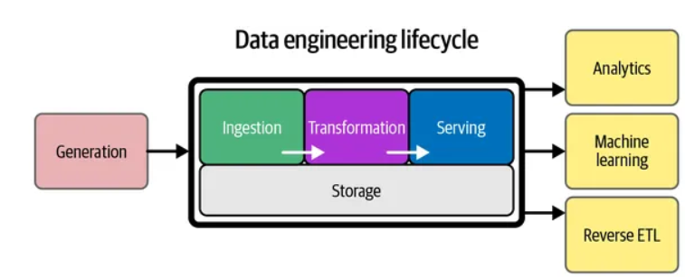
Lifecycle
Data Mining:
Process that uses both human and computer resources
Typically, 3 stages
Hypothesis / objective determination
Data Preparation
Data Mining
Data Engineering:
Five-stage process that transforms data into a useful product
Generation
Ingestion
Storage
Transformation
Serving
Notes:
2

Slide 7
Challenges and Best Practices
Data Mining:
Challenges
Data Quality
Data Privacy and Security
Handling Complex and diverse data types
Scalability and Efficiency
Integration with different Data Sources
Best Practices
Collect and preprocess data
Choose the appropriate data mining techniques
Incorporate results into decision making
Data Engineering:
Challenges
Data Discovery
Choosing the Right Tools
Data Quality
Minimizing Human Error
Maintaining Data Pipelines
Best Practices
Designing for scalability and performance
Ensure data quality
Implement robust error handling
Maintain documentation
Monitor and logging
Adhere to security and privacy standards
Notes:
2

Slide 8
Impact on Business
Data Mining:
Plays a crucial role in helping businesses get closer to their customers
Extracting and discovering valuable data to help with trends and hidden patterns
This information can be used to make smart business decisions and improve customer relationships
Competitor analysis to unlock strategic moves
Understand your competition by gathering information such as pricing and product offerings and understand who the customers are.
Accurate customer segmentation
Segmentation allows businesses to tailor their products to a specific customer group
Results in improved numbers
Data Engineering:
Can have a positive impact on businesses
When data is organized, businesses can make more informed decisions
Businesses can analyze customer data to tailor their products and services better to meet their needs
Well-managed data can help identify areas of improvement, leading to smoother business operations
Error-free and agile data can lead to higher productivity and performance, which can lead to an increase of a business ROI
Notes:
2

Slide 9
Real World Solutions
Data Mining:
Real-world fields
Healthcare
Ecommerce / Retail
Banking
Television and radio
Characteristics of Becoming a Data Miner
Proficient in programming languages (Python and or R)
Proficient in Linux-based systems
Database knowledge
Basic knowledge in statistics
Knowledge in machine learning algorithms
Great communication skills
Data Engineering:
Real-world fields
Healthcare
Ecommerce / Retail
Banking
Television and radio
Characteristics of Becoming a Data Engineer
Analytical mindset
Programming skills
Database management knowledge
Attention to detail
Great problem skills and communication\ skills
Notes:
2

Slide 10
Conclusion
Data Mining and Data Engineering are closely related disciplines that both use data to extract insights
Huge impact in today’s industry by transforming raw data into actional insights.
Two fundamental pillars in Data Science
Both Data Mining and Data Engineering contribute to informed decision-making, enhanced customer relationships, and give companies a competitive edge
By embracing these challenges and best practices, companies can overcome obstacles, significantly benefiting the overall business.
Notes:
2

Slide 11
QUESTIONS & DISCUSSION
Notes:
17

